Slide 1

Low-Dose PET Image Enhancement Using CycleGAN
Abhishek Raman

Slide 2
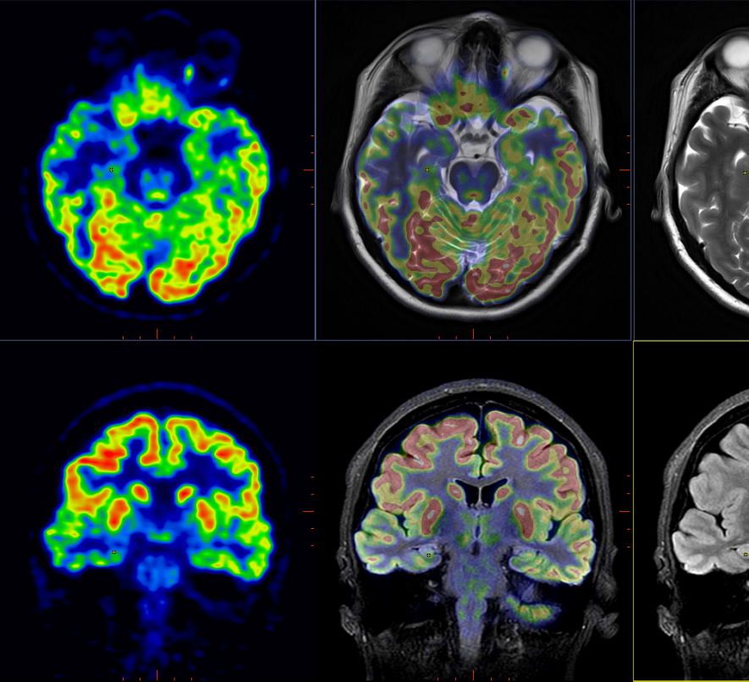
What is PET Imaging?
Functional imaging modality: images what tissue is doing, not what it looks like
Unlike CT or MRI, PET maps radiotracer distribution inside the body in 3D
Most common tracer: ¹⁸F-FDG, a radioactive glucose analogue
Tumors consume glucose at far higher rates than normal tissue
This makes PET sensitive to active disease even before a tumor is visible on CT or MRI
Used clinically in:
Oncology: staging, restaging, therapy response monitoring
Neurology: Alzheimer's diagnosis, seizure localization
Cardiology: myocardial viability
Image quality has direct clinical consequences — it informs real treatment decisions
This Photo by Unknown Author is licensed under CC BY

Slide 3
How PET Works (Physics)
A radiotracer undergoes beta-plus decay, emitting a positron from the nucleus
The positron travels a short distance in tissue (0.5–2.4 mm for ¹⁸F) then annihilates with a nearby electron
Annihilation produces two 511 keV gamma photons traveling in exactly opposite directions
Detector rings surrounding the patient record both photons within a coincidence timing window of 2–10 ns
Each detected pair defines a line of response (LOR) and the annihilation happened somewhere along that line
Millions of LORs are collected and organized into a sinogram
The sinogram is reconstructed into a 3D activity map using iterative algorithms

Slide 4
PET Reconstruction and SUV
Raw sinogram data must be reconstructed before it can be interpreted
Iterative algorithm that models Poisson photon counting statistics
Corrections applied before reconstruction:
Attenuation correction (CT-derived tissue absorption map)
Scatter correction (removes photons that changed direction)
Random coincidence correction (subtracts accidental photon pairs)
Key clinical output: Standardized Uptake Value (SUV) SUV = C(t) / (D / BW)
Normalizes uptake across patients with different body sizes and injected doses
SUV accuracy depends entirely on image quality
Noise inflates SUV variability and can push measurements across clinical decision thresholds

Slide 5
Clinical Uses of PET
Oncology
Staging and restaging of lymphoma, lung cancer, colorectal cancer, melanoma
Monitoring therapy response mid-treatment
Detecting recurrence after remission
Neurology:
Amyloid and tau PET for Alzheimer's disease diagnosis
Seizure focus localization before surgery
Cardiology:
Myocardial viability assessment
Cardiac sarcoidosis detection
PET findings inform decisions
Whether to escalate or de-escalate chemotherapy
Whether a patient is a surgical candidate
Whether a lesion requires biopsy

Slide 6
Dose Problem
Standard whole-body ¹⁸F-FDG scan: 3–7 MBq/kg injected activity
Effective radiation dose per scan: 7–14 mSv
Radiation risk is cumulative across a patient's lifetime
High-risk groups:
Children (more radiosensitive, longer remaining lifetime)
Cancer patients requiring repeated scans during treatment
Clinical trial participants with multiple imaging timepoints
Patients with hereditary cancer syndromes requiring frequent surveillance
Lower dose = safer for patients, but fewer detected photons
Fewer photons = more noise = worse image quality
This is the fundamental tradeoff the project attempts to address computationally

Slide 7
What Happens When You Reduce Dose
Fewer photons detected → higher Poisson noise in the sinogram
SNR scales as the square root of count rate:
Halving the dose reduces SNR by a factor of 1.41
Quartering the dose reduces SNR by a factor of 2
Visual effects on the reconstructed image:
Granular noise throughout
Reduced contrast between lesion and background
Loss of fine structural detail
Small lesions can fall below detection threshold entirely
Quantitative effects:
SUV estimates become less stable
Wider confidence intervals around measurements
Measurements can spuriously cross clinical response thresholds
Net result: lower dose directly compromises both diagnostic sensitivity and quantitative reliability

Slide 8
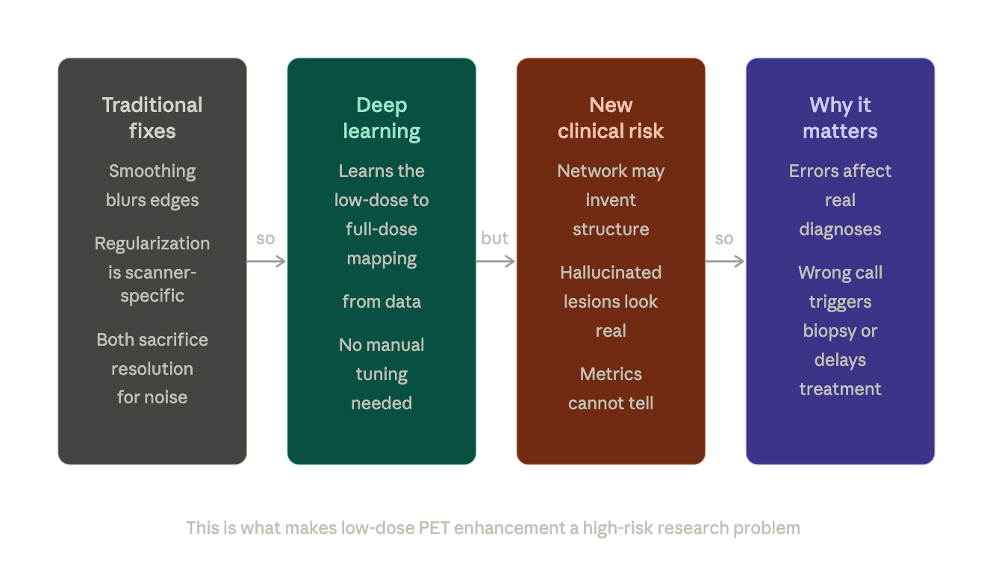
Why this is Hard to Fix

Slide 9
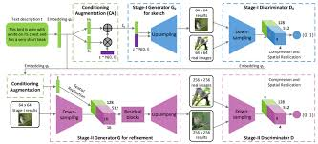
Generative Adversarial Networks
Two networks trained in competition against each other:
Generator G: takes noise or an input image and produces a synthetic output
Discriminator D: tries to tell real images apart from generated ones
Generator wants to fool the discriminator
Discriminator wants to correctly classify real vs fake
They push each other to improve through competition
Common failure modes:
Mode collapse: generator produces only a limited variety of outputs
Training instability: discriminator becomes too confident, gradients vanish
Stabilization strategies: LSGAN loss, spectral normalization, Wasserstein distance

Slide 10
GAN Training
Generator and discriminator are never trained at the same time
Each iteration:
Freeze generator, update discriminator on real and fake batches
Freeze discriminator, update generator based on discriminator feedback
Generator never sees real images directly, only learns through discriminator signal
This creates a moving target problem: as one improves, the other must catch up
Equilibrium is theoretically defined but rarely cleanly reached in practice
LSGAN replaces the original log loss with squared error: L_GAN = E[(D(G(x)) − 1)²] + E[D(y)²]

Slide 11
From GANs to CycleGAN
Conditional GAN (cGAN): conditions both G and D on an input image, learns structured mappings
Pix2Pix: paired cGAN for image-to-image translation, requires pixel-aligned training pairs
Problem for PET: getting true paired low/full-dose images requires double injection or count decimation
CycleGAN solution: unpaired translation using two generators and cycle consistency
No matched pairs needed, train on any collection of low-dose and full-dose scans
Core innovation: cycle consistency loss forces generators to be approximate inverses of each other

Slide 12
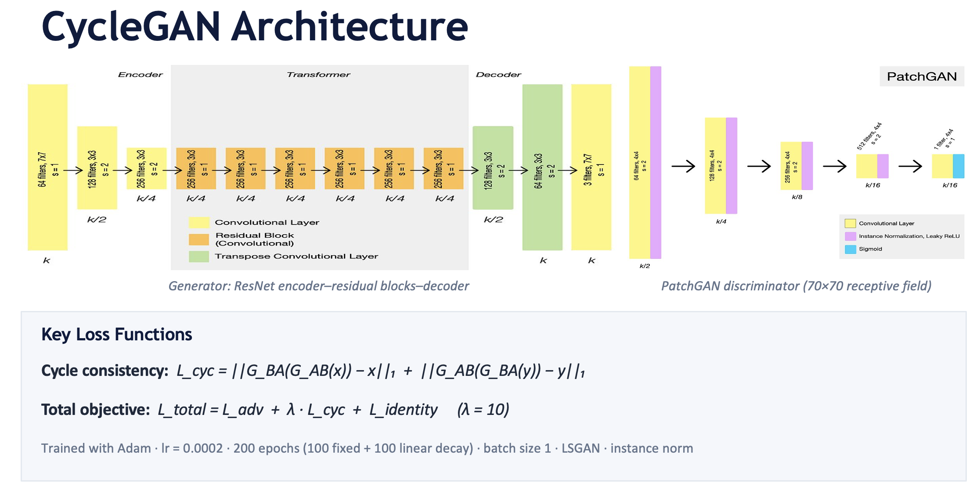

Slide 13
Dataset and Preprocessing
UDPET dataset: 1,447 whole-body ¹⁸F-FDG scans, 8 dose variants per patient
Dose factors: full-dose plus 2×, 4×, 5×, 10×, 20×, 50×, 100× reduction
Preprocessing pipeline:
DICOM loading: pydicom, converted to float32 3D volumes
Per-slice normalization: min-max to [−1, 1] independently per slice
Spatial standardization: center crop or zero-pad to 640×320
HDF5 storage: gzip compression, 5–15 MB per patient vs 200 MB raw
One model trained per dose factor, each learns dose-specific noise characteristics
Evaluated on 25 held-out patients, 15,146 coronal slices

Slide 14
Training Setup
Optimizer: Adam, learning rate 0.0002, beta1 = 0.5
Schedule: 100 epochs fixed learning rate, 100 epochs linear decay to zero
Batch size: 1 (GPU memory constraint at 640×320)
Loss: LSGAN adversarial + cycle consistency (λ=100) + identity loss
Instance normalization throughout, normal weight initialization
Discriminator history buffer of 50 images to prevent oscillation
Six metrics computed per slice: PSNR, NMSE, SSIM, LPIPS, GMSD, VIFp
Baseline: same metrics on raw low-dose input for direct comparison

Slide 15
RESULTS
Enhancement at a Glance
+5.97 dB
+0.124
74.6%
2.3×
PSNR improvement
SSIM improvement
LPIPS reduction
VIFp improvement
25 / 25
15,146
3.4%
−17.1 dB
patients improved
slices evaluated
slices degraded
worst-case degradation
All 25 test patients showed positive mean PSNR and SSIM improvement without exception

Slide 16
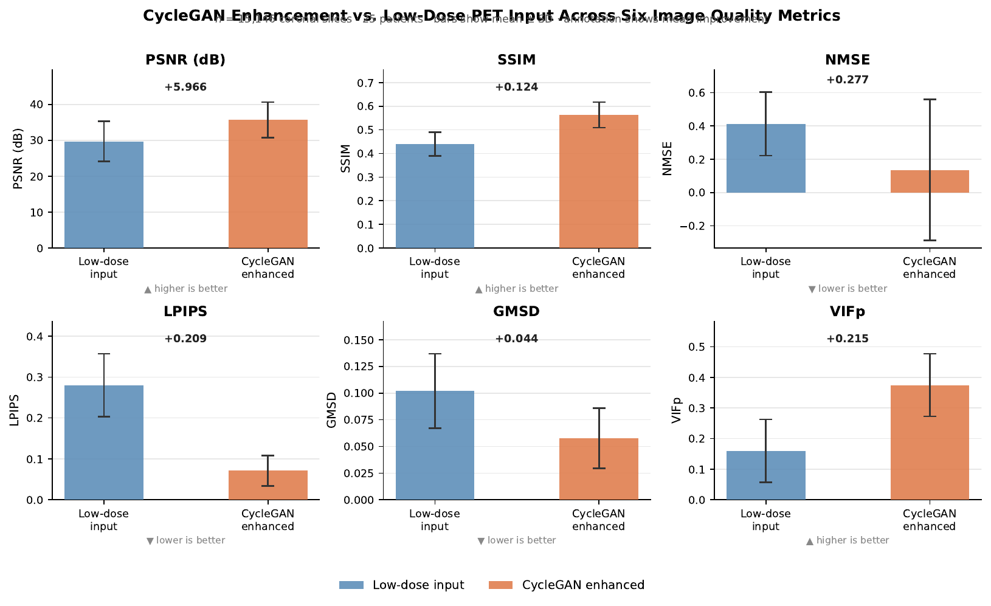
RESULTS
All Six Metrics — Input vs. Enhanced

Slide 17
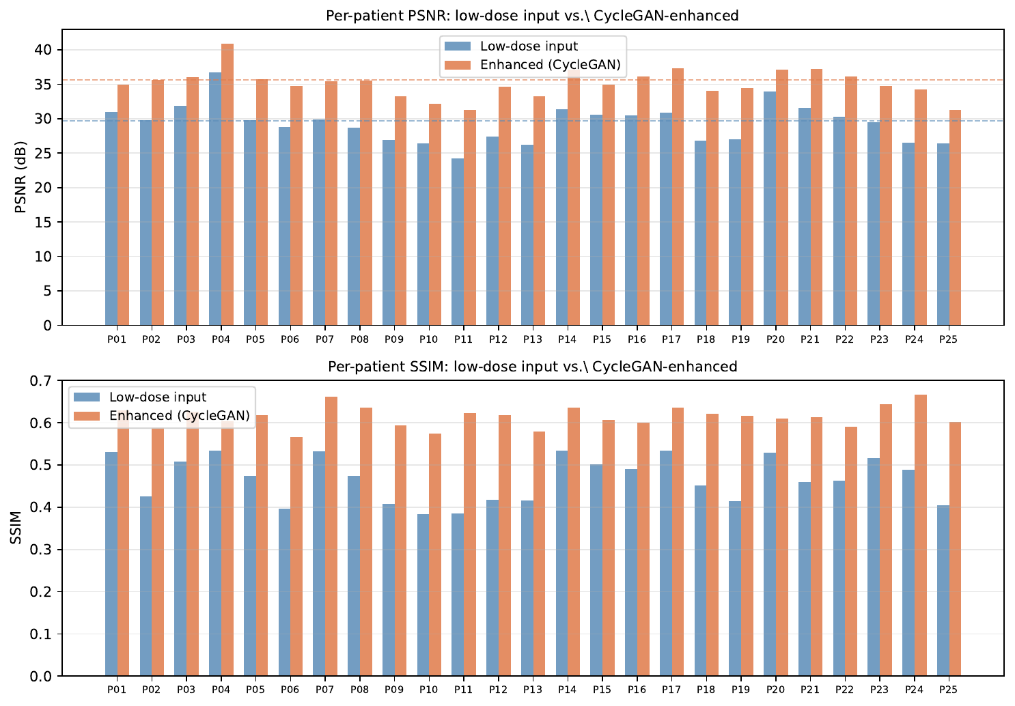
RESULTS
Consistent Improvement Across All 25 Patients
Key findings
Every patient improved
PSNR gain: +3.2 to +7.8 dB
SSIM gain: +0.07 to +0.24
Noisier inputs → larger gains
No patient harmed on average
Per-patient mean PSNR (top) and SSIM (bottom) · blue = low-dose input · orange = CycleGAN enhanced

Slide 18
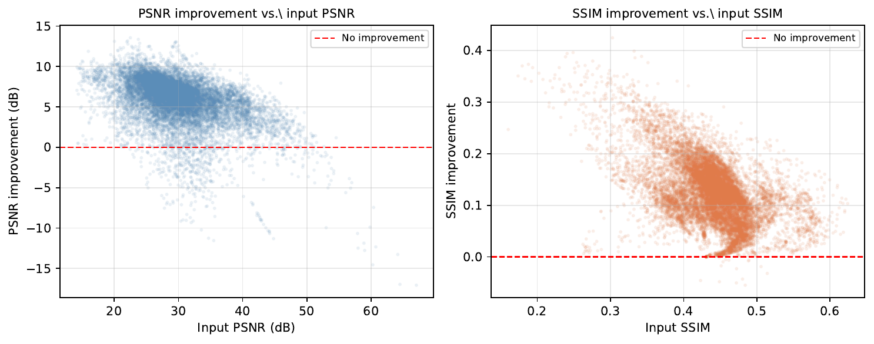
RESULTS
Failure Mode Analysis
3.4%
of slices degraded
−17.1 dB
worst-case drop
> 35 dB
failure concentrated here
Clinical implication: failure cases are not random noise; rather, they are systematic over-processing of slices already close to full-dose quality.

Slide 19
Discussion and Clinical Safety
Noise in low-dose PET is stochastic and well-characterized, radiologists can account for it
A hallucinated lesion is a systematic error that is indistinguishable from real signal
False positive: triggers unnecessary biopsy or therapy escalation
False negative: delays treatment of active disease
Standard metrics cannot identify which structures in an enhanced image are hallucinated
Clinical deployment would require lesion-level validation
This project demonstrates both the promise and the limits of generative PET enhancement

Slide 20
Discussion Continued
Limitations:
No lesion-level analysis conducted
No radiologist visual grading performed
No SUV preservation in terms of loss
Coronal orientation only
Single dose factor Evaluated
Future Work:
Multi-dose model
Monte Carlo Uncertainty Estimation
Clinical validation with radiologists
Volumetric 3D training

Slide 21
Summary
CycleGAN consistently improved low-dose PET image quality across all 25 patients and all six metrics
PSNR +5.97 dB, SSIM +0.124, LPIPS reduced 74.6%, VIFp more than doubled
Largest gains in the patients who need dose reduction most: those with the noisiest baselines
3.4% of slices degraded: systematic over-processing of high-quality inputs
Standard metrics are insufficient for clinical validation of generative enhancement
Path to deployment requires SUV validation, uncertainty quantification, and expert reader studies
This project frames PET enhancement as a high-risk research problem and identifies the right questions for future work

